Slide 1
6869i Phone Training
Kathleen Lee

Slide 2
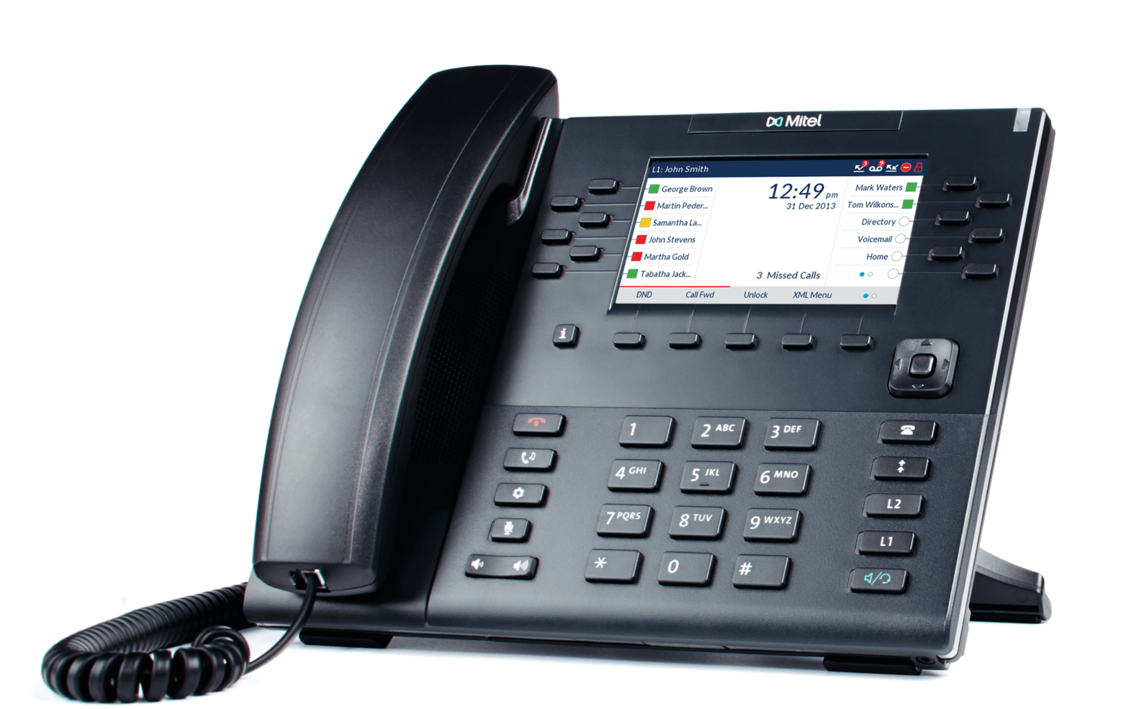
6869i
Phone Display / Buttons
Message Waiting Indicator
Goodbye
Navigation Keys
Hold
Callers
Options
Redial
Mute
Line 1 and 2 with LED
Speaker / Headset
Volume
Notes:
Phone Display

Slide 3
6869i
Soft Keys
Notes:
Soft Keys

Slide 4
6869i
Disconnect Button
Goodbye
Notes:
Disconnect Button

Slide 5
6869i
Mute
Mute
Notes:
Mute

Slide 6
6869i
Volume
Volume
Notes:
Volume

Slide 7
6869i
Message Waiting Indicator
Message Waiting Indicator
Notes:
Message Waiting Indicator

Slide 8
6869i
Navigation Pad
Navigation Keys
Notes:
Navigation Pad

Slide 9
6869i
Callers Menu
Callers
Notes:
Callers Menu

Slide 10
6869i
Redial
Redial
Notes:
Redial

Slide 11
6869i
Line 1 and Line 2
Line 1 and 2 with LED
Notes:
Line 1 and Line 2

Slide 12
6869i
Speaker Phone
Speaker / Headset
Notes:
Speaker Phone

Slide 13
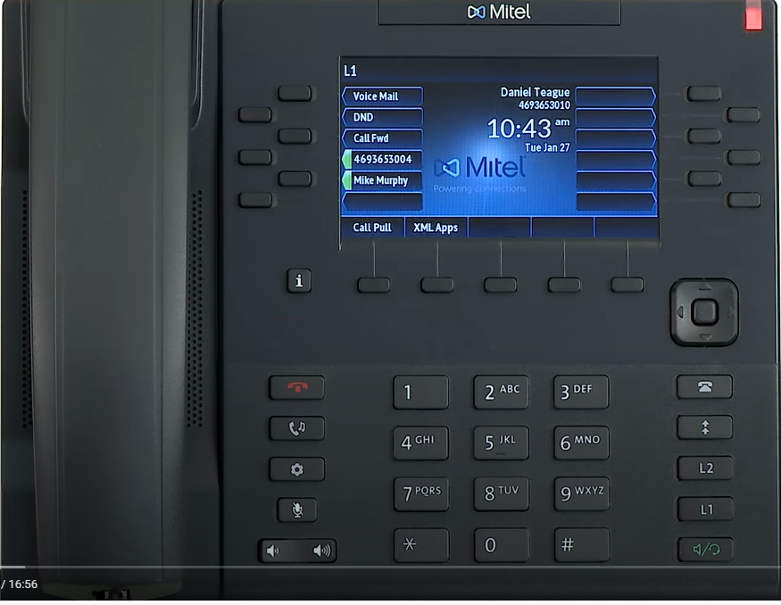
6869i
Do Not Disturb

Slide 14
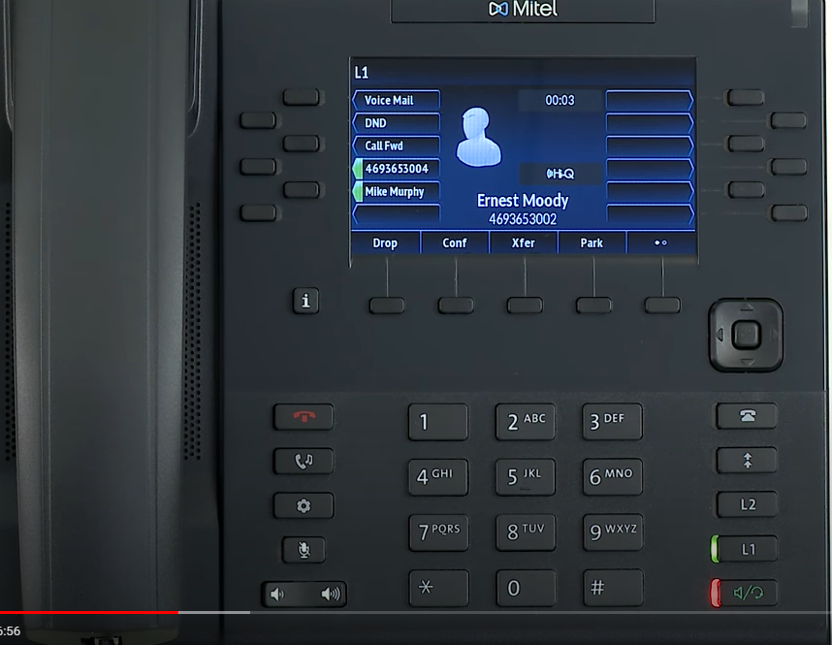
6869i
Transfer

Slide 15
6869i
Conference

Slide 16
6869i
Call Forward

Slide 17
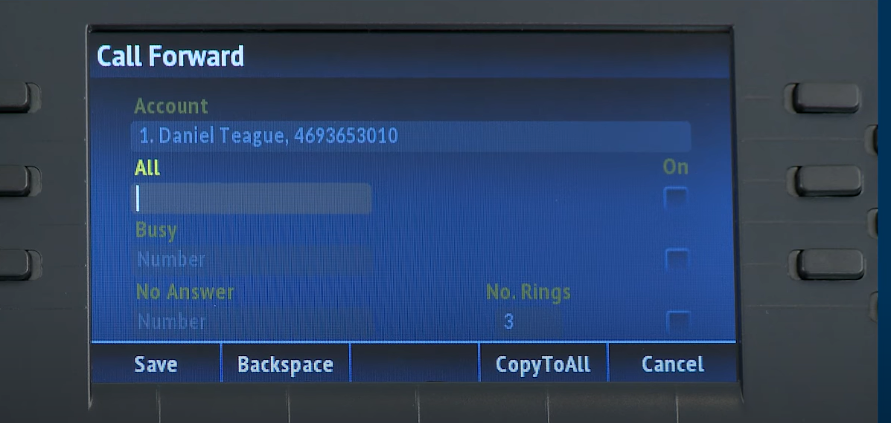
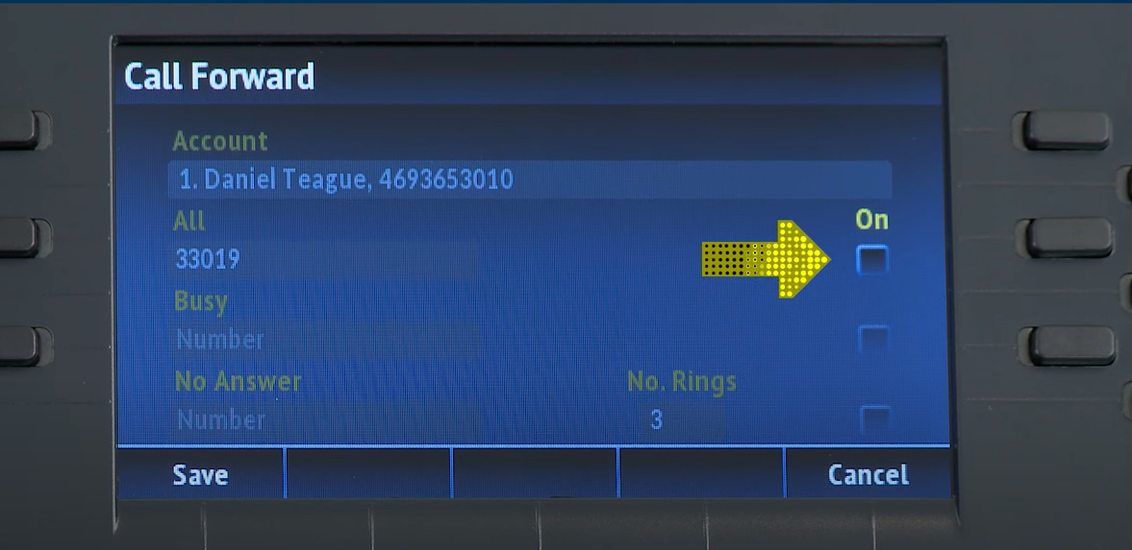
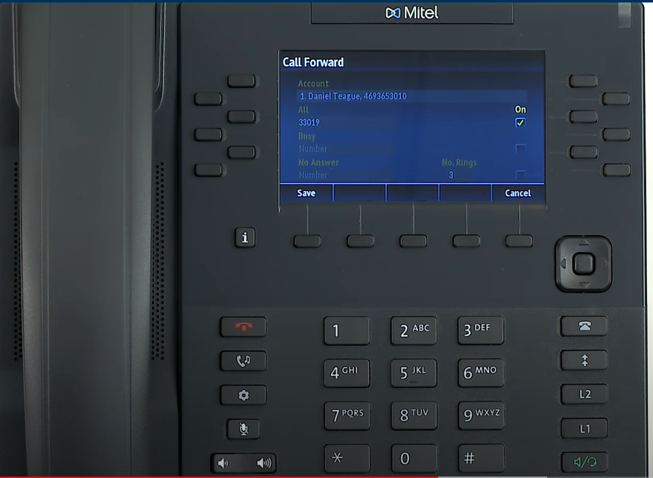
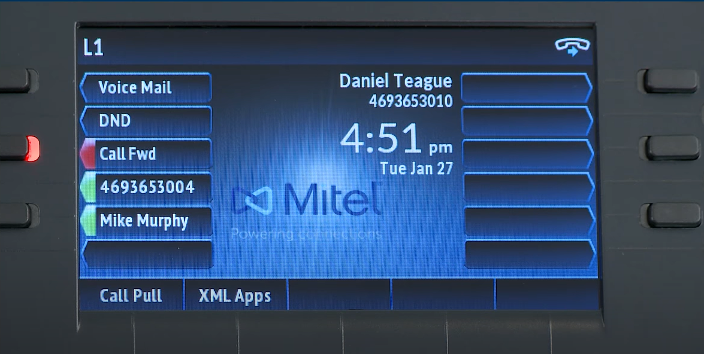
6869i
Call Forward
Enter number & press middle of Navigation key

Slide 18
6869i
Speed Call 100

Slide 19
Speed Call 100
To Program:
Press Speed 100 Key
Press Options
Press ADD
Number - This is speed dial code 00-99
Press Done
Number – Dial in number of person you are saving (without 9 or 1)
Press Done
Name – Use touchtone pad to type in name
Press Done
To use:
Press Speed Call 100 key
Use Navigator key to scroll to number you want to dial
Press Dial or middle of Navigator key

Slide 20
Call Park and Pickup

Slide 21
6869i
Voicemail
To set up voicemail press the Voicemail key and enter the default password: 739146. You will be asked to change this to a 6-digit password. You will then be asked to record your name and the mailbox is activated
To retrieve messages, press the Voicemail key & enter your password.

Slide 22
Thank You

